Slide 1
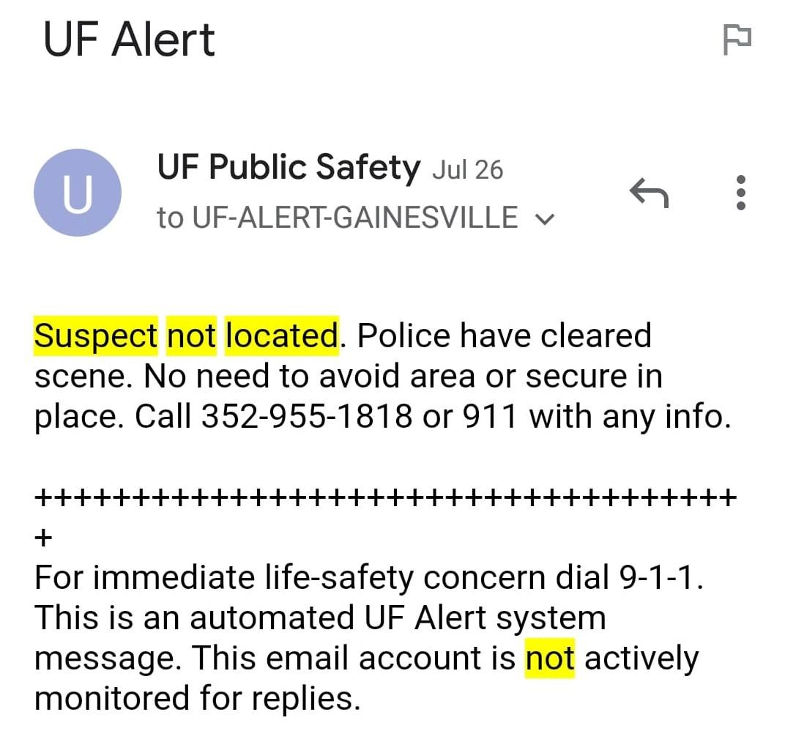
Final Presentation
Analysis of Gainesville Crime Incidents using Frequent Pattern Mining and Classification Methods
Group 2: Natalia Lisiecka Zhengyang Liu
Arham Khan Adnan Mustafic

Slide 2
Goals and datasets
Find spatial and temporal criminal hotspots in Gainesville.
Find spatial and temporal criminal hotspots in Gainesville.
Find spatial and temporal criminal hotspots in Gainesville.
Find spatial and temporal criminal hotspots in Gainesville.
Find spatial and temporal criminal hotspots in Gainesville.
Find spatial and temporal criminal hotspots in Gainesville.
Find spatial and temporal criminal hotspots in Gainesville.
Find spatio-temporal criminal hotspots in Gainesville
Predict type of crime most likely to occur at given location and time
Identify areas that should be prioritized by the law enforcement
Gainesville Crime Incidents from 2011 to present
150k rows
218 classes
21 columns
imbalanced distribution

Slide 3
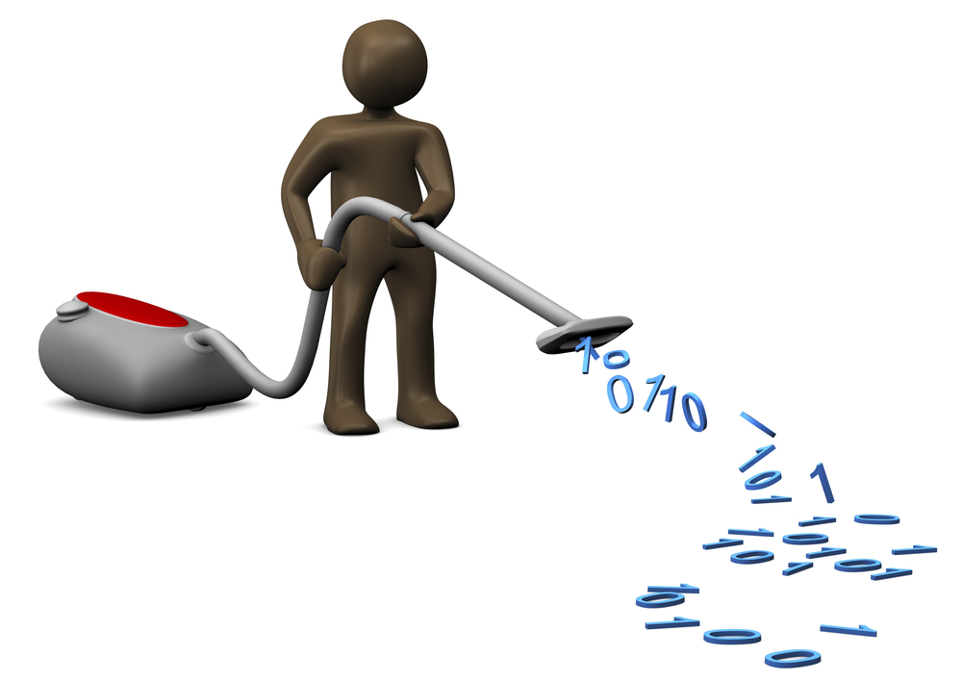
Data science systems and tools used
Data Preprocessing
Select relevant attributes and discretize crime types into groups
Data reduction
Select biased and redundant classes and remove them
Cleaning data
Removing missing values or incorrect formats

Slide 4

Data science algorithms and tools used
Frequent Pattern Mining
FP-Growth Algorithm
Classification
K-Nearest-Neighbors
Stochastic Gradient Descent
Random Forest
XGBoost
LightGBM

Slide 5
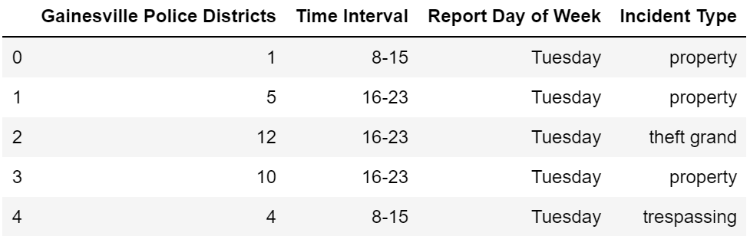
Evaluation and results
Frequent Pattern Mining
Data Frame

Slide 6
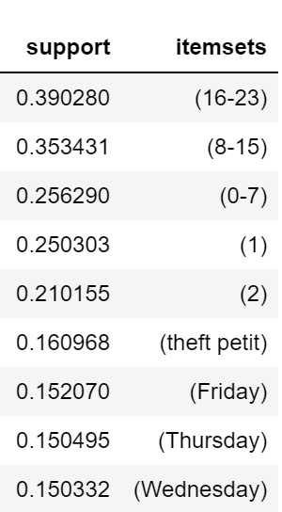
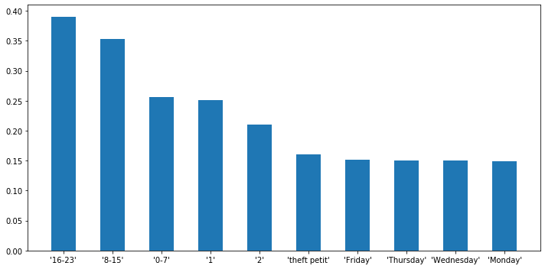
10 itemsets with highest support
Time Interval
Police District
Incident Type
Day of the week

Slide 7
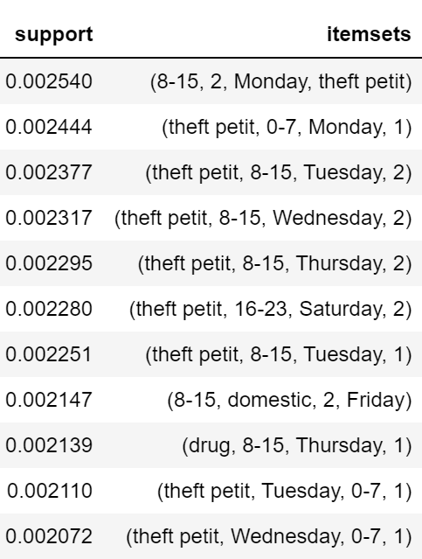
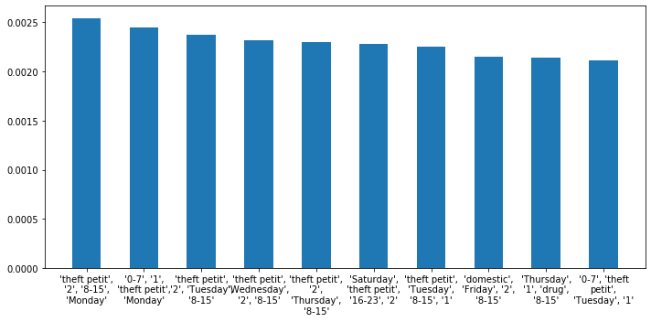
10 itemsets with the highest support

Slide 8
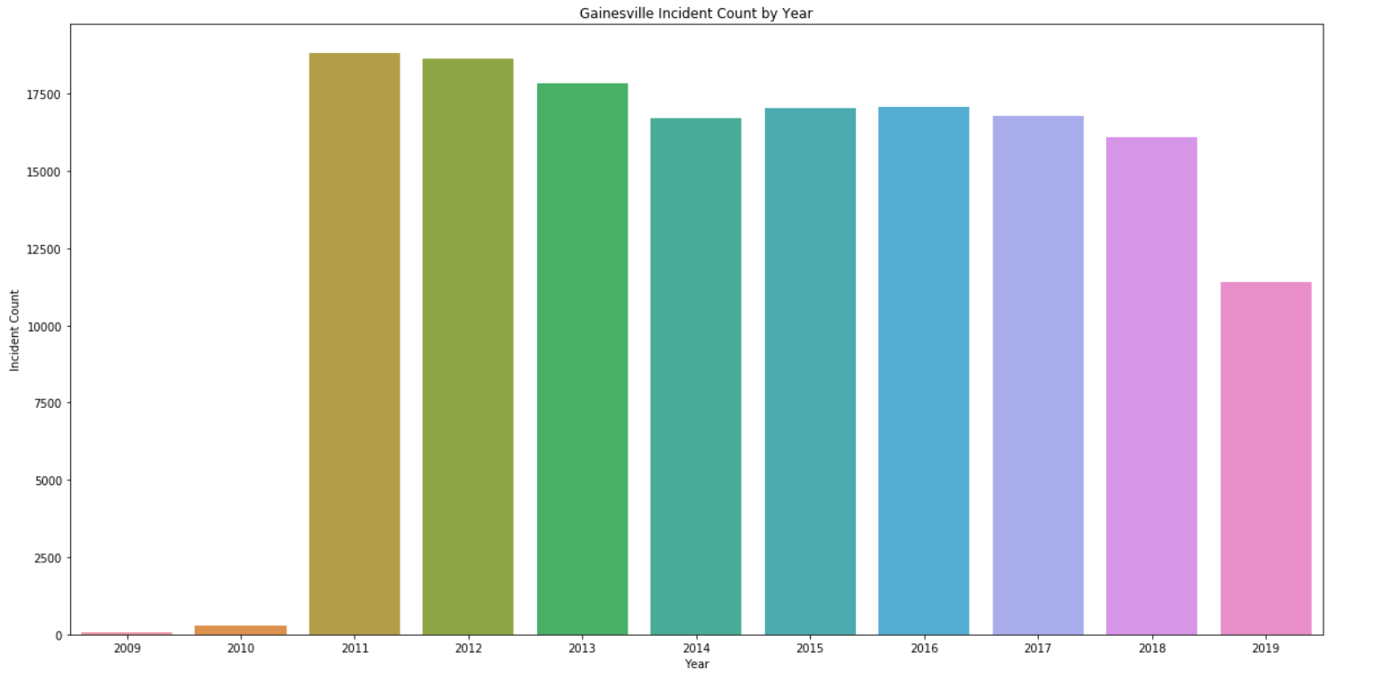
Incident by Year

Slide 9
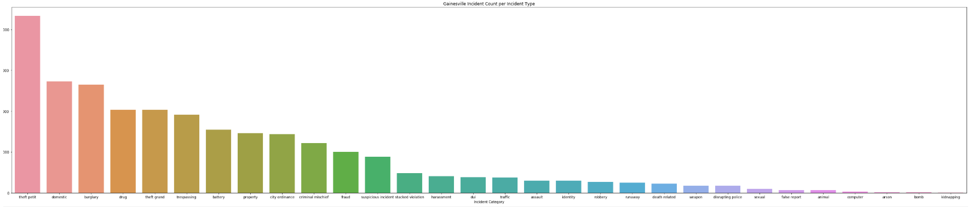
Incident by Type of Crime

Slide 10
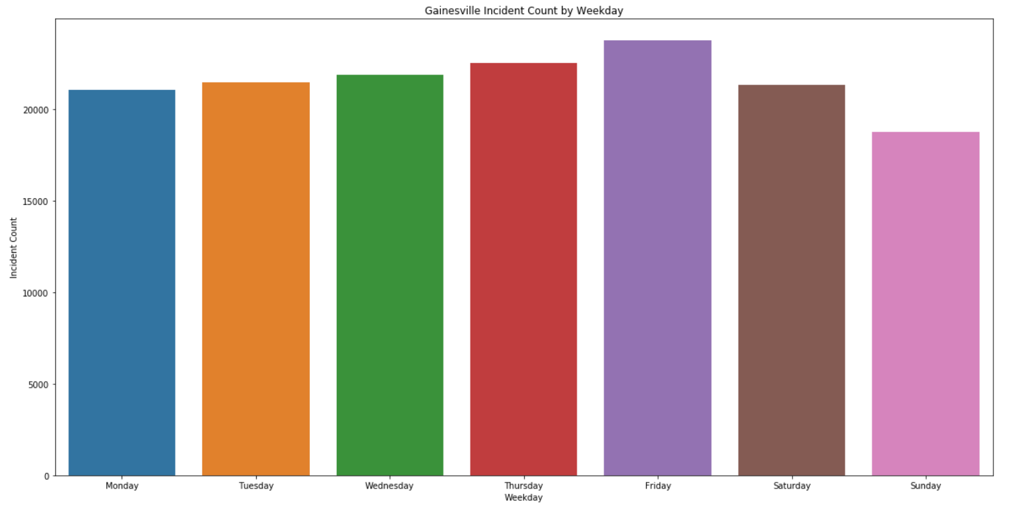
Incident by Weekday

Slide 11
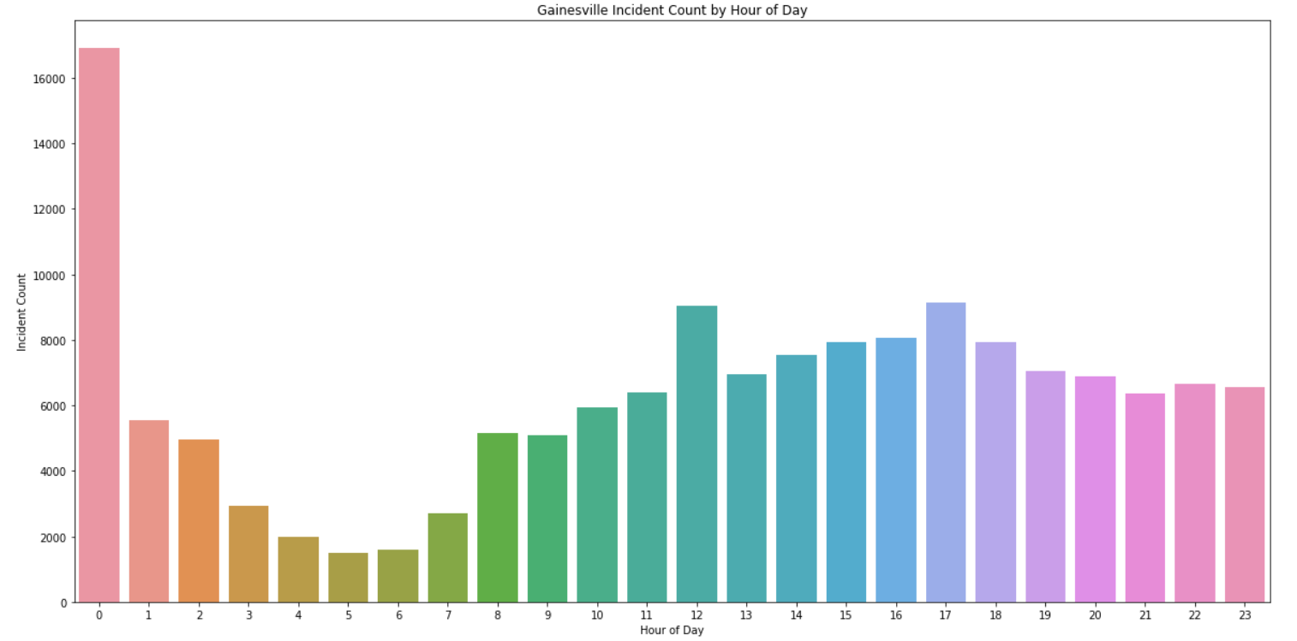
Incident by Hour of Day

Slide 12
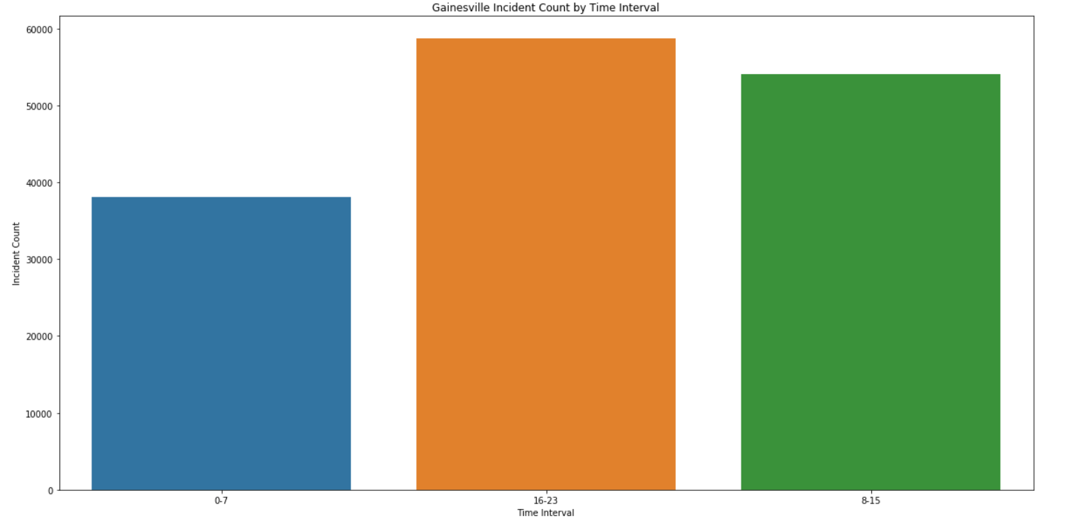
Incident by Time Interval

Slide 13
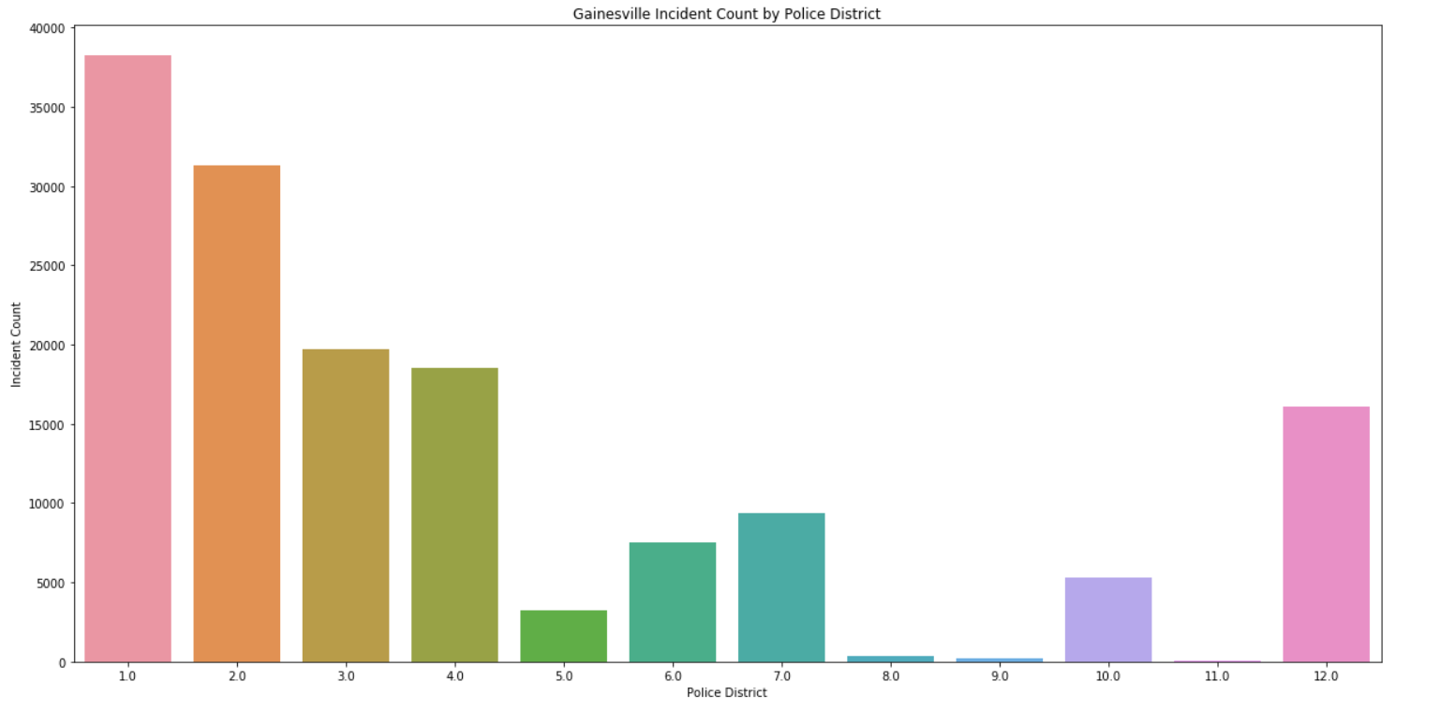
Incident by Police District

Slide 14
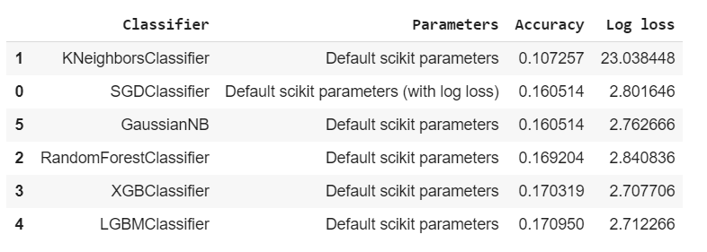
Classification baseline

Slide 15
Baseline Classification Results
Model | Accuracy | Log Loss
SGDClassifier | 0.1605140013369977 | 2.8016460336777107
KNearestNeighbors(5) | 0.107256926390849 | 23.038447782085186
RandomForest | 0.16920448637005125 | 2.8408359476314486
XGBoost | 0.17031865111787864 | 2.707706279422326
LightGBM | 0.16910126268878437 | 2.696430274684188
NaiveBayes | 0.1605140013369977 | 2.7626660598501442
Multilayer Perceptron | 0.159593958900718 | 2.7924863251124177

Slide 16
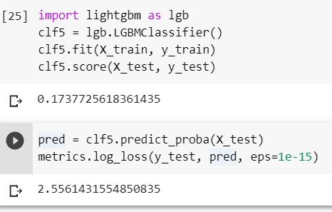
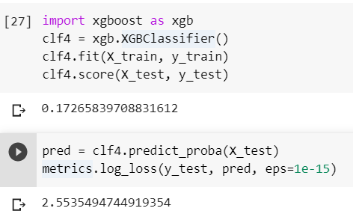
Dimensionality reduction - class number

Slide 17
Challenges:
numerous heavily
imbalanced classes
small dataset
Improvements:
feature selection
parameter tuning
time granularity
crime grouping
resampling

